Slide 1
CSCI2100B: Data Structure Lecture 1: Introduction
Keren Zhu
kerenzhu@cse.cuhk.edu.hk

Slide 2
Announcement
Tutorials will be hold in SC LG23
HW1 is out, due Jan 23

Slide 3
Class One Outline
Welcome to Data Structures
We will learn fundamental data structures and algorithms for organizing and processing information
Classic data structures and algorithms
Analyze efficiency
When to use
Today in class:
Course overview and policy
What this course is about
An example of abstract data structures

Slide 4

Course Staff
Keren Zhu
Instructor
Office: SHB128
Office hour: Monday 2:30pm - 3:30 pm
Works in electronic design automation
Contact: kerenzhu@cuhk.edu.hk

Slide 5
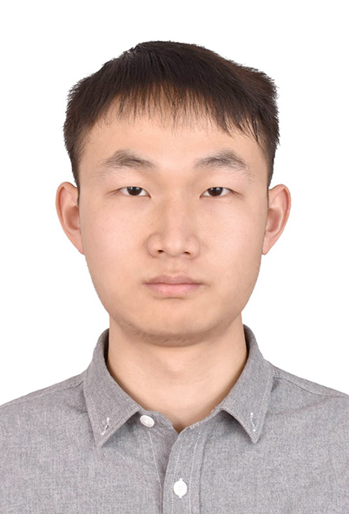
Course Staff
Liang XIAO
TA
Office: SHB913
Office hour: Wed 9:00-11:00AM
Contact: lxiao6623@gmail.com

Slide 6

Course Staff
Bin Xia
TA
Office: SHB904
Office hour: Thursday 4:00pm - 5:00 pm
Contact: zibinxia@gmail.com

Slide 7
Venue and time
Lectures
Mo 4:30PM - 6:15PM ERB LT
Tu 2:30PM - 3:15PM SC L1
Tutorials
Wed 5:30PM - 6:15PM SC LG23 Instructed by Liang XIAO
(Wed 5:30PM - 6:15PM ERB 407)
Th 5:30PM - 6:15PM SC LG23 Instructed by Bin XIA
Go over exercise problems and examples
We won’t record attendance, but attending lectures and tutorials in principle are required
Quizzes will be given during the lecture time (will be announced before classes)
If you are not sure, email us in advance

Slide 8
Grading policy
Assessment types
Written homework sets 30%
Programming assignments 14%
Quizzes 6%
Midterm Exam 20%
Final Exam 30%
All the assignments shall be done in individual
Discussion is encouraged, but plagiarism is prohibited

Slide 9
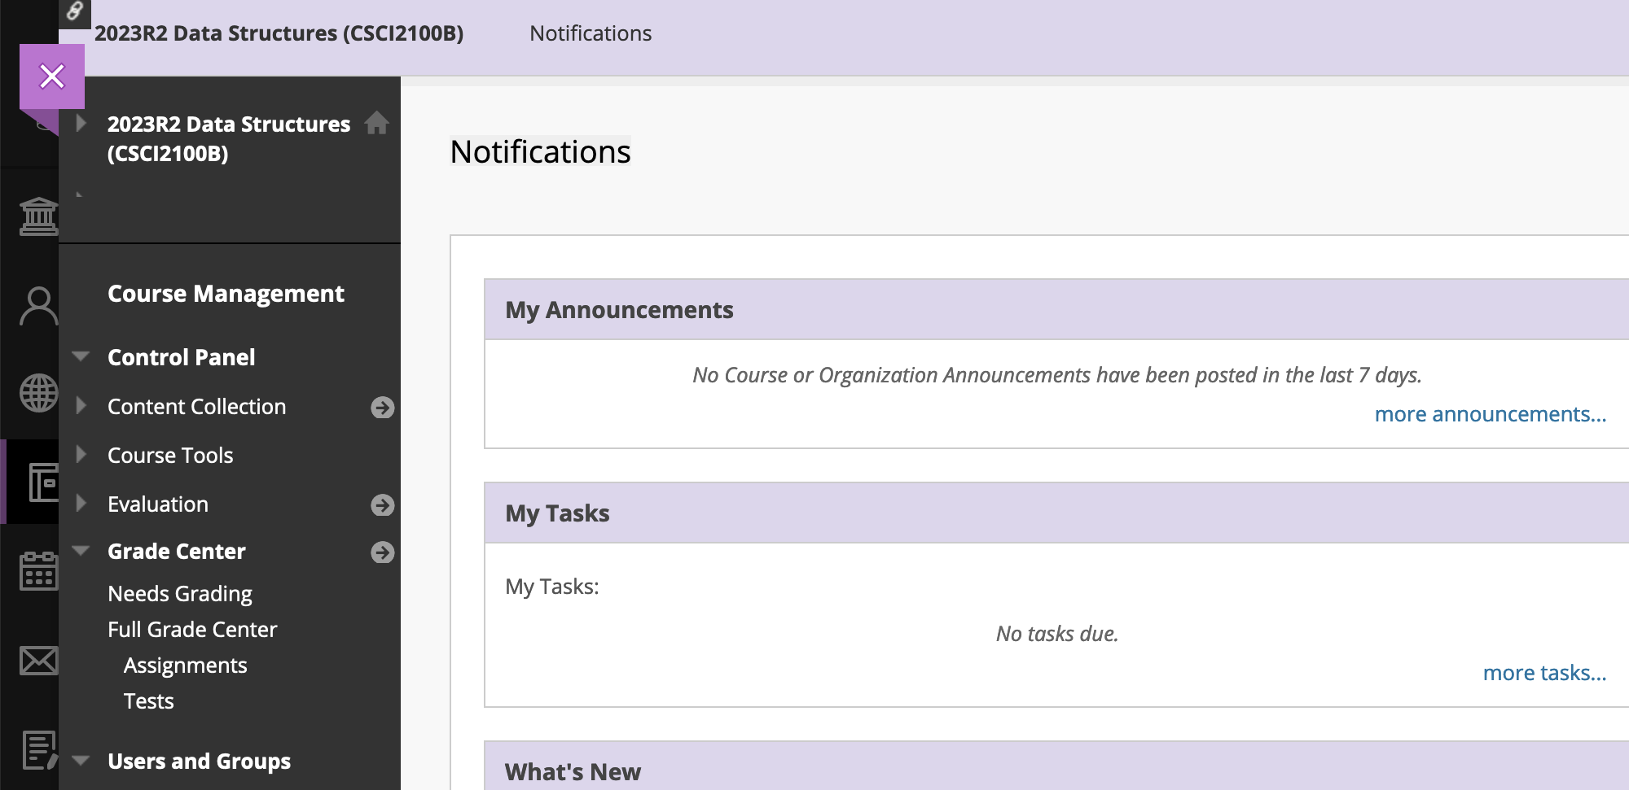
Homework
6 homework sets (tentative)
Around 5 problems per homework set
Will be posted online and due in Tuesday
Suggest to submit a PDF to blackboard.cuhk.edu.hk
Also allow to hand-in a paper version in class
For electronic version, either a scanned or a document is fine (like MS Word and LaTeX)

Slide 10
Programming assignments
2 assignments (tentative)
To submit the source codes and a report to Blackboard
The report shall contain:
A detailed code walkthrough
Testcases and examples
Other requested report (like experiments over runtime complexity)
Programming language and development enviroment is not restricted
Suggested: C++ and Linuxs
Other programming languages are accepted but our supports are limited (like C, Java, Python, etc.)
Should implement the codes as instructed (don’t just use std::sort when being asked to implement a sorting algorithm)
Can be done in either CSE servers or personal computers

Slide 11
Quizzes and examples
Quizzes will be hold in class
2 quizzes (tentative)
About 20 mins
Will be announced in advance
Closed book and closed notes
Aim to be a practice for the exams
Two exams
Closed book and closed notes
Calculator is not needed
Time and location TBD

Slide 12
Policy on AI tools
GPT is prohibited for all assignments!
Why?
You can directly find answers (can even write codes for you)
Data structures is a fundamental skill set
You cannot consult AI in everyday work
But
Free feel to use AI tool to help you understand a concept

Slide 13
Things to do for the first week
Read course website https://www.cse.cuhk.edu.hk/~kerenzhu/csci2001b/
Read the assigned reading for week 1
Check Blackboard blackboard.cuhk.edu.hk
Tutorials:
Setting up coding environments
Mathematical induction

Slide 14
Data structures
A data structure is a way to organize information to enable efficient computation over that information
What are some examples?
push
pop
enqueue
dequeue
First-in-last-out
First-in-first-out

Slide 15
Trade-offs
A data structure strives to provide many useful, efficient operations.
But there are unavoidable trade-offs:
Time vs space
One operation’s efficiency vs another
Generality vs simplicity vs performance
So, when should I use different data structures

Slide 16
Terminology
Abstract Data Type (ADT)
Mathematical description of a “thing” with set of operations
Not concerned with implementation details
Data structure
A specific organization of data and family of algorithms for implementing an ADT
Algorithm
A high level, language-independent description of a step-by-step process
Implementation of a data structure
A specific implementation in a specific language

Slide 17
Example: Stacks
The Stack ADT supports operations:
isEmpty
push
pop
What else?
A Stack data structure could use a linked-list or an array and associated algorithms for the operations
One implementation is in the library std::stack
push
pop

Slide 18
Why Useful
Stack ADT arises all the time in programming
Recursive function calls
Balancing symbols in programming (parenthesis)
Evaluating postfix notation: 3 4 + 5 *
Conversion from infix ((3+4)*5) to postfix notation
We can code up a reusable library
We can communicate in high-level terms

Slide 19
Stack Implementations
stack as an array
stack as a linked list
Initially empty
Push(‘a’)
Push(‘b’)
Pop()

Slide 20
The Queue ADT
Operations
enqueue
dequeue
is_empty
What else?
Just like a stack except:
Stack: LIFO (last-in-first-out)
Queue: FIFO (first-in-first-out)
Next: implementation
Back
Front
enqueue
dequeue

Slide 21
Circular Array Queue Data Structure
Q:
0
size - 1
b
c
d
e
f
front
back
// Basic idea only!
enqueue(x) {
next = (back + 1) % size
Q[next] = x;
back = next
}
What if queue is empty?
What if array is full?
How to test for empty?
What is the complexity of the operations?
Can you find the k^{th} element in the queue?
Why do we use a circular array for a queue vs a standard array for a stack?
// Basic idea only!
dequeue() {
x = Q[front];
front = (front + 1) % size;
return x;
}

Slide 22
In Class Practice
back
front
enqueue(‘A’)
enqueue(‘B’)
enqueue(‘C’)
o = dequeue()
o = dequeue()
enqueue(‘D’)
enqueue(‘E’)
enqueue(‘F’)
enqueue(‘G’)
enqueue(‘H’)
enqueue(‘I’)
// Basic idea only!
enqueue(x) {
next = (back + 1) % size
Q[next] = x;
back = next
}
// Basic idea only!
dequeue() {
x = Q[front];
front = (front + 1) % size;
return x;
}

Slide 23
b
f
f
b
enqueue(‘A’)
enqueue(‘B’)
enqueue(‘C’)
o = dequeue()
A
f
b
A B
f
b
A B C
f
b
B C

Slide 24
f
b
o = dequeue
enqueue(‘D’)
enqueue(‘E’)
enqueue(‘F’)
enqueue(‘G’), enqueue(‘H’)
enqueue(‘i’)
C
f
b
C D
f
b
C D E
f
b
C D E F
b
f
G H C D E F

Slide 25
Linked List Queue Data Structure
b
c
d
e
f
front
back
// Basic idea only!
enqueue(x) {
back.next = new Node(x);
back = back.next;
}
What if queue is empty?
Enqueue?
Dequeue?
Can list be full?
How to test for empty?
What is the complexity of the operations?
Can you find the k^{th} element in the queue?
// Basic idea only!
dequeue() {
x = front.item;
front = front.next;
return x;
}

Slide 26
Circular Array vs. Linked List
Array:
May waste unneeded space or run out of space
Space per element excellent
Operations very simple / fast
Constant-time access to k^{th} element
For operation insertAtPosition, must shift all later elements
Not in Queue ADT
List:
Always just enough space
But more space per element
Operations very simple / fast
No constant-time access to k^{th} element
For operation insertAtPosition must traverse all earlier elements
Not in Queue ADT

Slide 27
Conclusion
Abstract data structures allow us to define a new data type and its operations.
Each abstraction will have one or more implementations.
Which implementation to use depends on the application, the expected operations, the memory and time requirements.
Both stacks and queues have array and linked implementations.
We’ll look at other ordered-queue implementations later.

